Slide 1
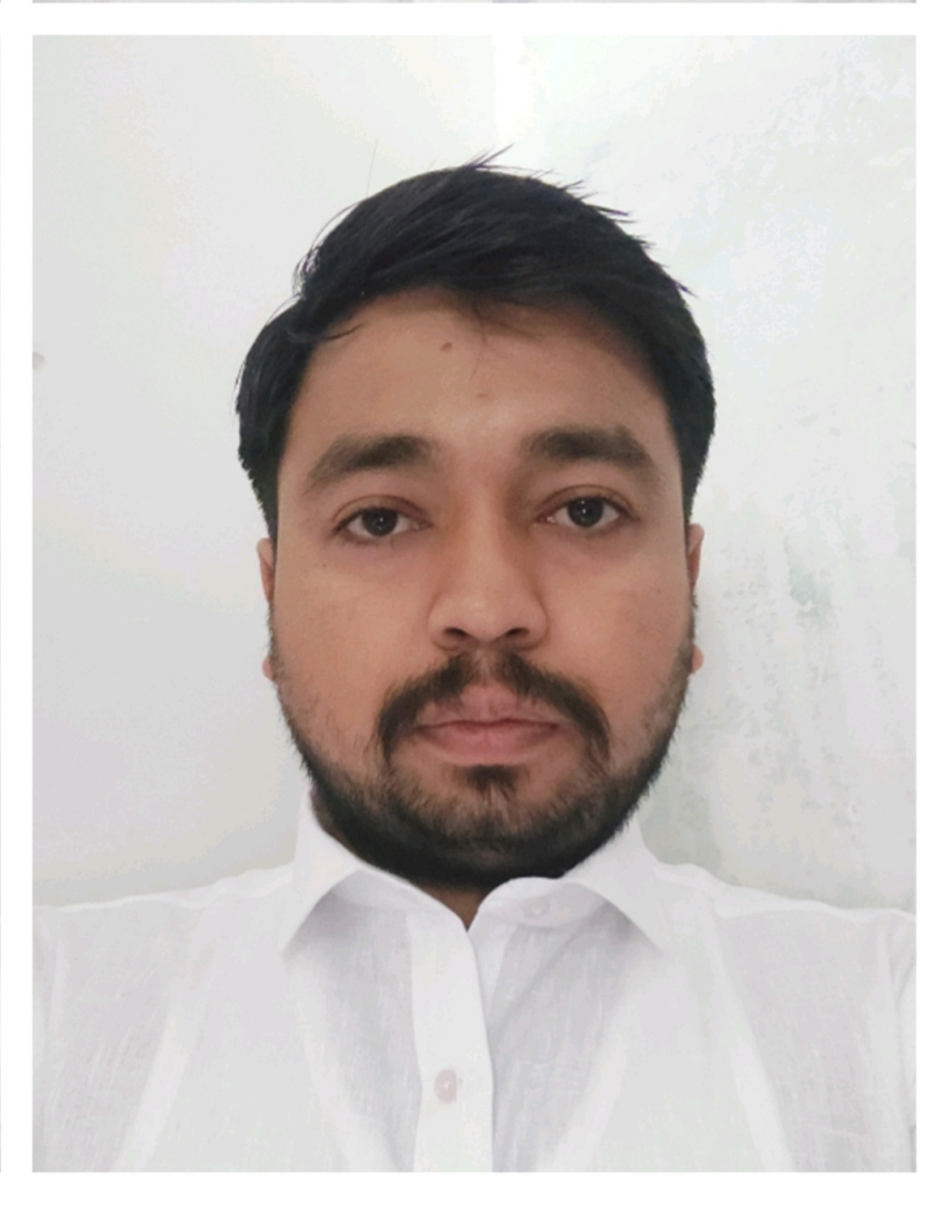



Abhishek Sathiya
Analyst/Software Engineer
Bachelor of Technlogy,
MECHANICAL :2017-2021
SKILLS:
Mumbai
Abhishek.sathiya@capgemini.com
C# | C#Basics, OOPS, Generics, Collections, Arrays.
.NET | ADO.NET,ASP.NETCORE with WEB API, Entity Framework
Version Control Tool | Git, GitHub
Angular | Components, Services, Modules, Routing, Forms & Validation.
UI | HTML 5 & CSS 3,JavaScript, TypeScript ,Bootstrap
Database | Microsoft sql server
Tools | Git, SSMS, Visual Studio, Visual Studio Code
Add On Skills | Self Learning and Upskilling
+91 9636913066
A4
Full Stack Developer
Hands on experience on C#,ADO.NET, LINQ, Entity framework, Sql Server, ASP.NET CORE with WEB API in ECommerce Shopping Store Project created with Database First Approach and layered architecture pattern.
Knowledge on creating Single page Web Application in Angular .
knowledge on creating databases in SSMS
Having Knowledge on Git And GitHub
Currently learning on itransform Microsoft .netcore and Azure Administrator AZ-104 certification.
ECommerce Shopping Store
Case study of ECommerce Shopping Store along with API Gateway, Swagger, and payment , responsive UI with HTML5,CSS3, Angular used as User Interface.
Degreed :
Successfully completed the degreed training in git,html,css, sql C#, .Net Core, Angular
Certifications:​
AZ-900​
Agile Software Development Certificate
Carrer Framework Assesment Test
Check out my work on GitHub

